Slide 1
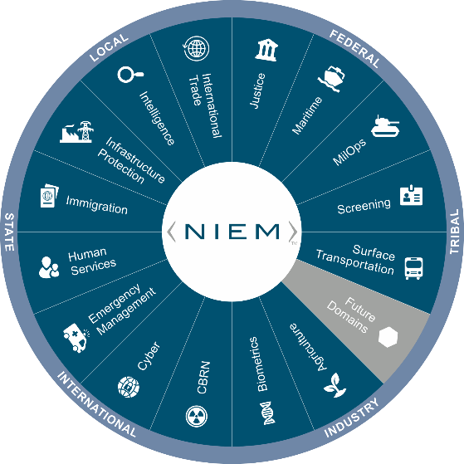
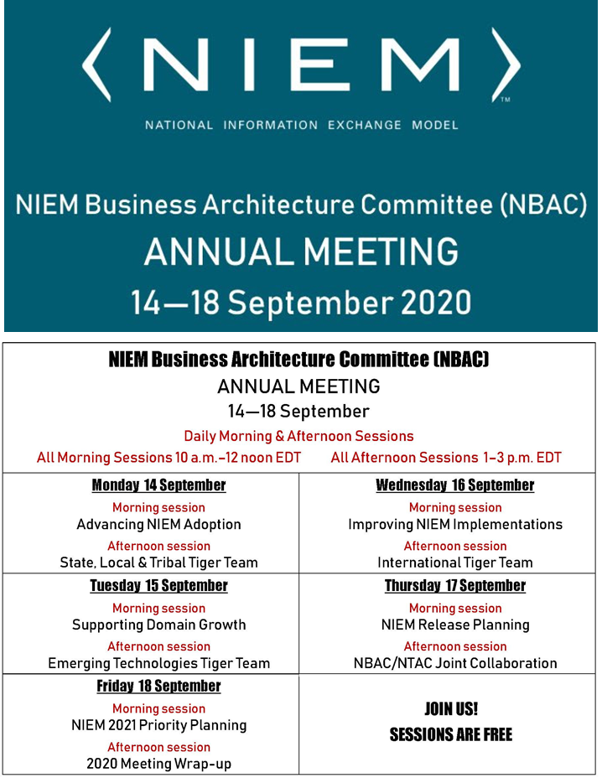


Virtual Annual Meeting (NBAC)
17 September 2020 → 10-12PM
NIEM Release Planning
Christina Medlin
christina.medlin@gtri.gatech.edu
Webb Roberts
webb.roberts@gtri.gatech.edu

Slide 2
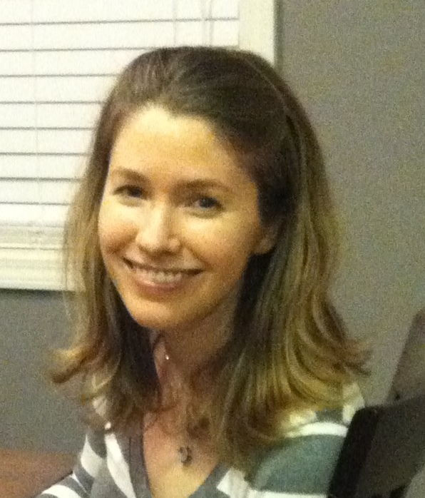



HOUSEKEEPING:
MUTE your mic when you’re not talking
Identify yourself before you start to speak
Speak clearly
Disable “call waiting” feature (the clicking noise can be heard by all)
Please note: All 2020 sessions are audio recorded for NIEM training & communications purposes
QUESTIONS & ANSWERS ARE ENCOURAGED!
To signal you want to contribute without interrupting the speaker
Enter comments via CHAT window at any time
To signal a question or respond to a question
Click on ‘Raise your hand’ button on meeting toolbar
(Lower hand after you’ve talked by clicking hand button again)
All session briefings are available on NIEM’s GitHub for download as they occur
SPEAKERS
Facilitator
Christina Medlin
Facilitator
Webb Roberts
https://github.com/NIEM/NIEM-Annual-Meetings/tree/master/2020
2

Slide 3
Session Agenda
NIEM 5.0 release update
Status and major changes
Harmonization Working Group activities
Issue management
Resources and artifacts
Release statistics
Discussion and feedback about the release process
NIEM 5.1 Plans
NIEM 5.0 specifications update (Webb Roberts)
NIEM models (Webb Roberts)
Domain Management Activities

Slide 4
NIEM 5.0 release update
NIEM 5.0 Release Candidate (RC) 1 status
Major content additions
Controlled Unclassified Information (CUI) metadata
Generic Statistical Information Model (GSIM) content
Public Health Emergency Operations Center (PHEOC) Minimum Data Set additions
FBI code set harmonization
Moved Core code elements to code namespaces
Replaced full set of GML schemas with a simplified profile
Many harmonization updates
Release package changes
Simplified folder layout
New auxiliary content
Updated character encoding from US-ASCII to UTF-8
Added xml:lang attribute to reference schemas

Slide 5
Harmonization work group
Representatives from domains, NBAC, NTAC, and community
Met roughly every two weeks
Focus
Harmonized objects across Core and domains
User-submitted and QA issues
Represented domains with currently lapsed governance
Used the NIEM-Releases GitHub repo for issue management
Created issues to track individual topics
Used a project to track issue status

Slide 6
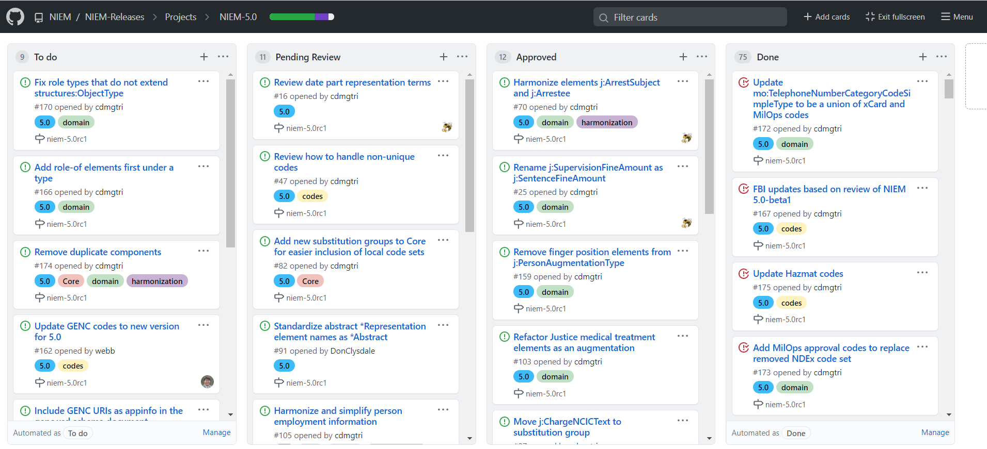
NIEM 5.0 Issue Tracker
https://github.com/NIEM/NIEM-Releases/projects

Slide 7
NIEM Release resources
NIEM-Releases GitHub repository
https://github.com/NIEM/NIEM-Releases
Release artifacts and packages
Issue tracker (issues and projects)
Wiki with some additional documentation
Release information niem.github.io
https://niem.github.io/niem-releases
Status on latest draft release
Instructions and links for all releases
Reference information on niem.github.io
https://niem.github.io/reference/
NIEM concepts, including XML and JSON examples and schema snippets
Help on using NIEM tools (SSGT, Movement, ConTesA, Migration Tool)
Overview of NIEM specifications

Slide 8
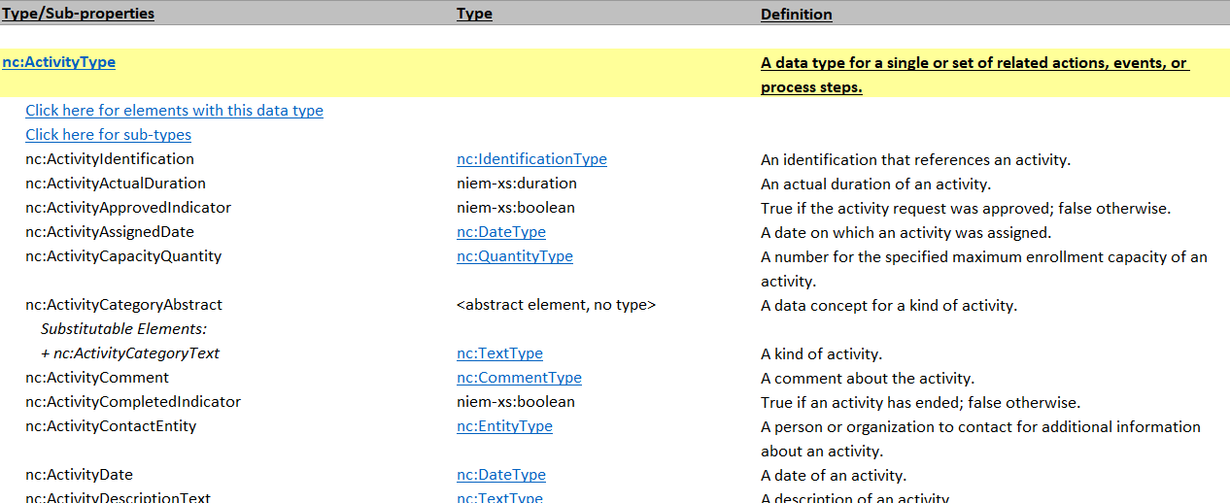
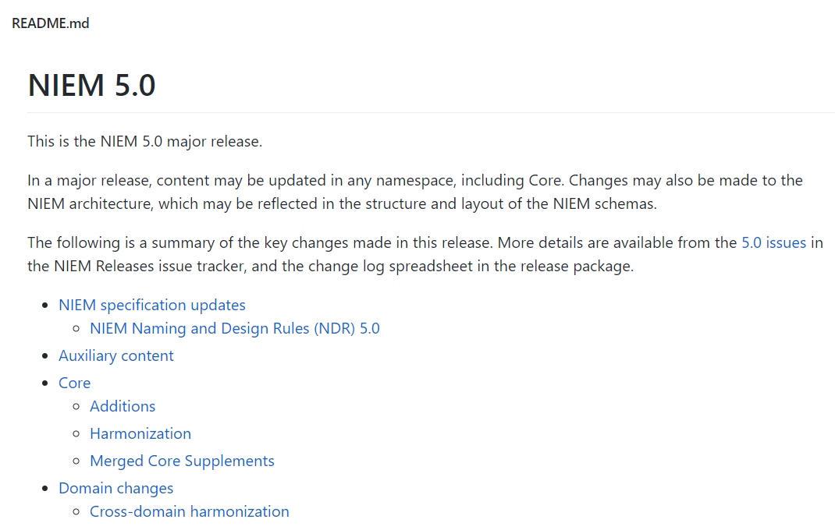
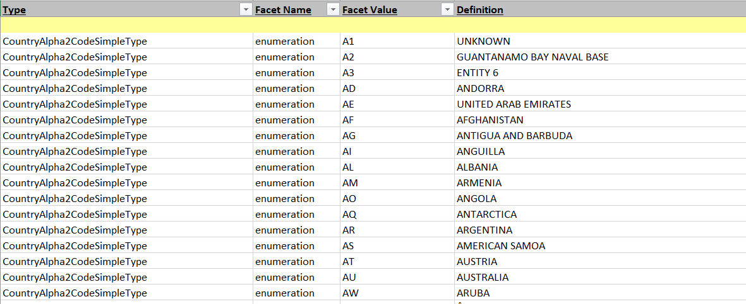
NIEM 5.0 artifacts walk-through
https://github.com/NIEM/NIEM-Releases

Slide 9
NIEM 5.0-RC1 Release stats
 | Properties | Types | Codes
Core | 1,810 | 282 | 101
Domains | 9,743 | 2,551 | 9,590
Agriculture | 64 | 8
Biometrics | 1,008 | 590 | 1,327
CBRN | 592 | 137
Emergency Management | 918 | 365 | 1,240
Human Services | 806 | 275 | 1,048
Immigration | 445 | 94 | 1,388
Infrastructure Protection | 31 | 8 | 3
Intelligence | 56 | 14
International Trade | 530 | 90
Justice | 4,023 | 489 | 361
Maritime | 333 | 47 | 180
Military Operations | 296 | 130 | 134
Screening | 577 | 253 | 3,731
Surface Transportation | 64 | 51 | 178
Auxiliary | 539 | 145 | 171
CUI | 19 | 12 | 164
Statistics | 520 | 133 | 7
Code Sets | 56 | 1,022 | 80,421
Grand Total | 12,148 | 4,000 | 90,283

Slide 10
NIEM Historical Element stats
# Elements | 1.0 | 2.0 | 2.1 | 3.0 | 3.1 | 3.2 | 4.0 | 4.1 | 4.2 | 5.0-RC1
Core | 1,540 | 1,478 | 1,478 | 1,423 | 1,423 | 1,423 | 1,586 | 1,586 | 1,586 | 1,810
Agriculture |  |  |  |  |  |  | 64 | 64 | 64 | 64
Biometrics |  |  |  | 240 | 617 | 707 | 1,018 | 1,014 | 1,012 | 1,008
CBRN |  |  | 451 | 630 | 608 | 608 | 608 | 608 | 608 | 592
Emergency Management | 176 | 169 | 261 | 295 | 295 | 548 | 670 | 687 | 822 | 918
Family Services / CYFS |  |  | 213 | 609 | 609 | 609
Human Services |  |  |  |  | 53 | 82 | 684 | 812 | 812 | 806
Immigration | 343 | 325 | 343 | 464 | 464 | 464 | 457 | 457 | 457 | 445
Infrastructure Protection | 23 | 22 | 25 | 31 | 31 | 31 | 31 | 31 | 31 | 31
Intelligence | 82 | 72 | 77 | 72 | 72 | 72 | 66 | 66 | 66 | 56
International Trade | 119 | 114 | 451 | 540 | 538 | 538 | 534 | 534 | 534 | 530
Justice | 1,300 | 1,236 | 1,386 | 2,828 | 2,832 | 4,173 | 4,140 | 4,147 | 4,206 | 4,023
Maritime |  |  | 438 | 359 | 359 | 359 | 339 | 339 | 339 | 333
Military Operations |  |  |  |  | 190 | 217 | 213 | 306 | 306 | 296
Screening | 507 | 487 | 571 | 599 | 599 | 599 | 599 | 599 | 599 | 577
Surface Transportation |  |  |  |  |  | 39 | 63 | 63 | 63 | 64
CUI |  |  |  |  |  |  |  |  |  | 19
Statistics (GSIM) |  |  |  |  |  |  |  |  |  | 520
Total | 4,090 | 3,903 | 5,694 | 8,090 | 8,690 | 10,469 | 11,072 | 11,313 | 11,505 | 12,092

Slide 11
NIEM 5.0 Discussion and feedback
What worked? What could be improved?
Release schedule
Harmonization work group
Issue management
etc.

Slide 12
NIEM 5.1 Plans
Minor release
Content changes to domains and domain code tables only
Core Supplement if needed
Expected new domains: Cyber, Grants
Projected schedule
Major inputs due End of year
Alpha 1 Feb 2021
Beta 1 May 2021
RC 1 Aug 2021
Release Fall 2021
Harmonization Work Group meetings if needed
Track updates at https://niem.github.io/niem-releases

Slide 13
NIEM 5.0 Specifications

Slide 14
NIem models

Slide 15
domain management activities
Some things to consider
Domain representation
Meetings
Content update process
Examples of different governance approaches
Justice (XSTF)
MilOps Configuration Control Board (CCB) meetings
Emergency Management

Slide 16
modeling tips
Collect and analyze local data requirements
Distinguish domain vs message content
Determine if data requirement sources should be tracked
Map local requirements to NIEM
Reuse existing NIEM components when possible
Model
Focus on actual requirements
Learn when NIEM uses augmentations vs extension vs roles
Learn how to construct NIEM property and type names
See reference for representation terms and definition phrases: https://niem.github.io/reference/concepts/property/modeling/table/
Avoid embedding grouping levels as much as possible
Submit new content early for feedback
Additional tips and resources available at https://niem.github.io/reference/concepts

Slide 17
NBAC Annual Meeting SESSION schedule
Session Date & Time |  | Session Topic | Planned Speakers | Facilitators
1 | Monday, 14 Sept 10 a.m. – Noon EDT | Advancing NIEM Adoption | Kshemendra Paul NIEM Executive Steering Council | Kamran Atri Thomas Krul
2 | Monday, 14 Sept 1 – 3 p.m. EDT | State, Local, Tribal Tiger Team | Eric Sweden National Association of State Chief Information Officers (NASCIO) | Cait Ryan, Tom Carlson Thomas Krul
3 | Tuesday, 15 Sept 10 a.m. – Noon EDT | Supporting Domain Growth | Brian Gattoni DHS CISA CTO | Kamran Atri Thomas Krul
4 | Tuesday, 15 Sept 1 – 3 p.m. EDT | Emerging Technologies Tiger Team | Syed Mohammed Director, US Department of Homeland Security, Modeling and Simulation Technology Center | Jalal Mapar Lain McNeill
5 | Wednesday, 16 Sept 10 a.m. – Noon EDT | Improving NIEM Implementation | Jon Kirk, Patrick Lagioia Treasury Board of Canada | Thomas Krul Kamran Atri
6 | Wednesday, 16 Sept 1 - 3 p.m. EDT | International Tiger Team | Poewan Lau | Thomas Krul Kamran Atri
7 | Thursday, 17 Sept 10 a.m. – Noon EDT | NIEM Release Planning | Working Session | Christina Medlin Webb Roberts
8 | Thursday, 17 Sept 1 - 3 p.m. EDT | NBAC/NTAC Collaboration Planning | Working Session | Kamran Atri , Webb Roberts Thomas Krul, Scott Renner
9 | Friday, 18 Sept 10 a.m. – Noon EDT | NIEM 2021 Priority Planning | Stuart Whitehead NIEM Executive Director | Katherine Escobar Stephen Sullivan
10 | Friday, 18 Sept 12 -12:15 p.m. | Annual Meeting 2020 Wrap-up |  | Kamran Atri Thomas Krul Stephen Sullivan

